Slide 1


PSA Proposed Comments Recorded during
Pre-Job Meeting

Slide 2

Proposed Pre-Job
Meeting Comments
Discuss as a team comments necessary to record & comments not needed
Next slides, review past meetings from App. & PJC Notes for examples
Suggestions from team on past items which caused issues and list examples

Slide 3
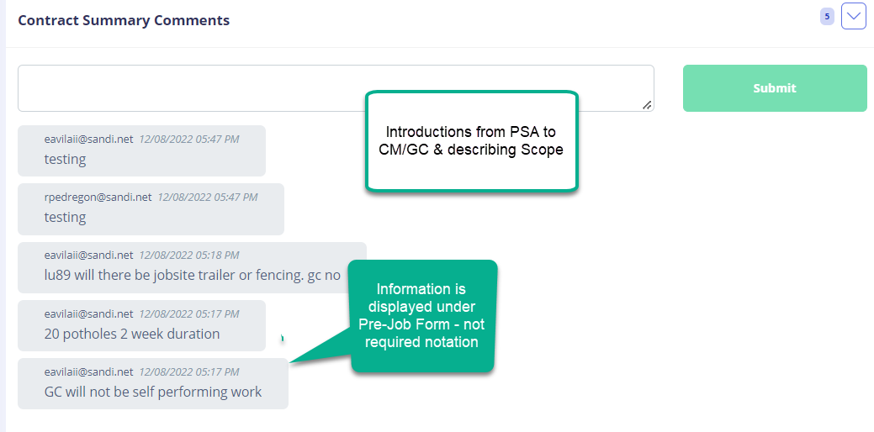
Pre-Job Comments Contract Summary
Summary – GC not performing is noted under PreJob Form

Slide 4
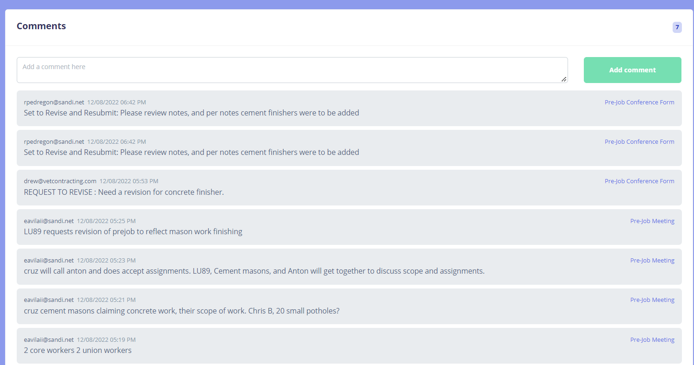
Pre-Job Sub Comments Review
Comments - feedback from Team on comments

Slide 5
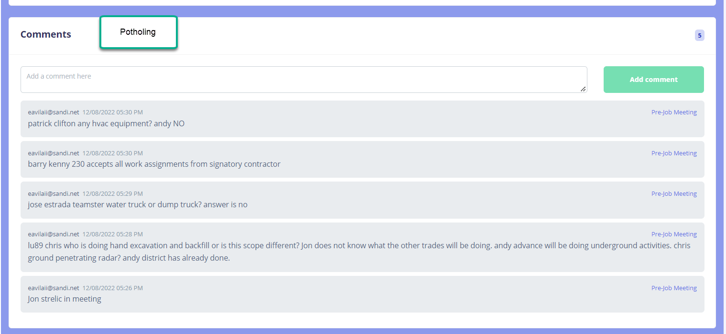
Pre-Job Sub Comments Review
Comments - feedback from Team on comments

Slide 6
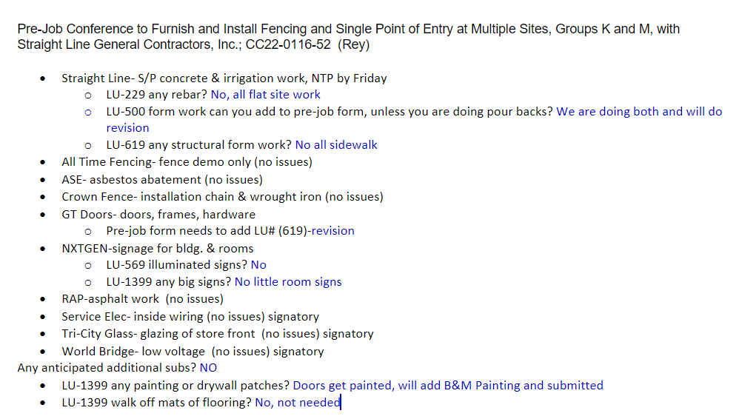
Pre-Job Notes (Maria Cruz)

Slide 7
Q&A

